Slide 1

Advance JavaScript
Object Oriented Programming
Lesson - 11

Slide 2
Objective
At the end of this session participants will be able to –
Create and use anonymous function
Create and use Closures
Serialize and deserialize JavaScript Object using JSON

Slide 3
Agenda
JavaScript Variable Scope
JavaScript Functions
Working with JavaScript Functions
JSON Object
JSON.stringify and JSON.parse

Slide 4
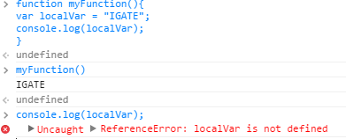
JavaScript Variable Scope
Local Variables –
Variables declared within a JavaScript function, become Local to the function.
Local variables have local scope i.e. They can only be accessed within the function.
Local variables are created at the beginning of function , and deleted at the end of function .
function myFunction() { var localVar = “iGate"; console.log (localVar); // code here can use localVar }
console.log (localVar); // code here can not use localVar

Slide 5
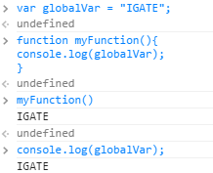
JavaScript Variable Scope (Contd.)
Global Variables -
A variable declared outside a function, is Global
A global variable has global scope i.e. all scripts and functions on a page can access it.
var globalVar = “IGATE";
function myFunction() { console.log (globalVar ); // code here can use globalVar }
console.log (globalVar ); // code here can use globalVar

Slide 6
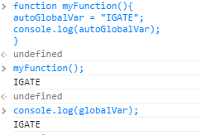
JavaScript Variable Scope (Contd.)
Auto Global Variables -
If you assign a value to a variable that has not been declared, it will automatically become a Global variable.
function myFunction() {
autoGlobalVar = “IGATE";
console.log (autoGlobalVar); // code here can access Variable }
console.log (autoGlobalVar ); // code here can access Variable

Slide 7
JavaScript Functions
JavaScript treats functions as objects(first-class functions).
In JavaScript functions can be instantiated, returned by other functions, stored as elements of arrays and assigned to variables.
A function with no name is called an anonymous function.
Closure is a function to which the variables of the surrounding context are bound by reference.
JavaScript function acts as a constructor when we use it together with the new operator
Notes:
Add instructor notes here.

Slide 8
Working with JavaScript Functions
Declaring the function anonymously
Invoking the anonymous function. Function executes immediately after declaration.
function(){
console.log(‘IGATE');
}
(function(){
console.log(‘IGATE');
})();
Notes:
Add instructor notes here.

Slide 9
Working with JavaScript Functions
Declaring a named function. function doSomething will be available inside the scope in which it’s declared.
Assigning function to a variable.
function doSomething(){
console.log('IGATE');
}
/* Inner Scope */
(function(){
doSomething();
})();
var doSomething = function(){
console.log(‘IGATE');
}
Notes:
Add instructor notes here.

Slide 10
Working with JavaScript Functions
/*Anonymous Closures*/
(function(){
var data = "Closing the variables inside the function from the rest of the world"
console.log(‘Closure Invoked');
})();
var employee = function(){
this.employeeId = 0;
this.name = "";
};
/* JavaScript function acts as a constructor */
var emp = new employee();
Notes:
Add instructor notes here.

Slide 11
JSON Object
JSONobject that provides functions to convert JavaScript values to and from the JavaScript Object Notation (JSON) format.
The JSON.stringify function serializes a JavaScript value to JSON text.
The JSON.parse function deserializes JSON text to produce a JavaScript value.

Slide 12
JSON.stringify
Converts a JavaScript value to a JavaScript Object Notation (JSON) string.
var contact = new Object();
contact.fnmame = "Donald";
contact.lname = "Duck";
var jsonText = JSON.stringify(contact);
console.log(jsonText);
{"fnmame":"Donald","lname":"Duck"}

Slide 13
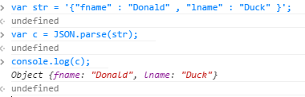
JSON.parse
Converts a JavaScript Object Notation (JSON) string into an object.
var jsontext = ‘{"fnmame":"Donald","lname":"Duck"}’;
var contact = JSON.parse(jsontext); console.log(contact.surname + ", " + contact.firstname);

Slide 14
Summary
In this lesson we have learned about –
JavaScript Functions
Working with JavaScript Functions
JSON Object
JSON.stringify and JSON.parse

